Slide 1
Cotton

Slide 2
Cotton Planting

Slide 3
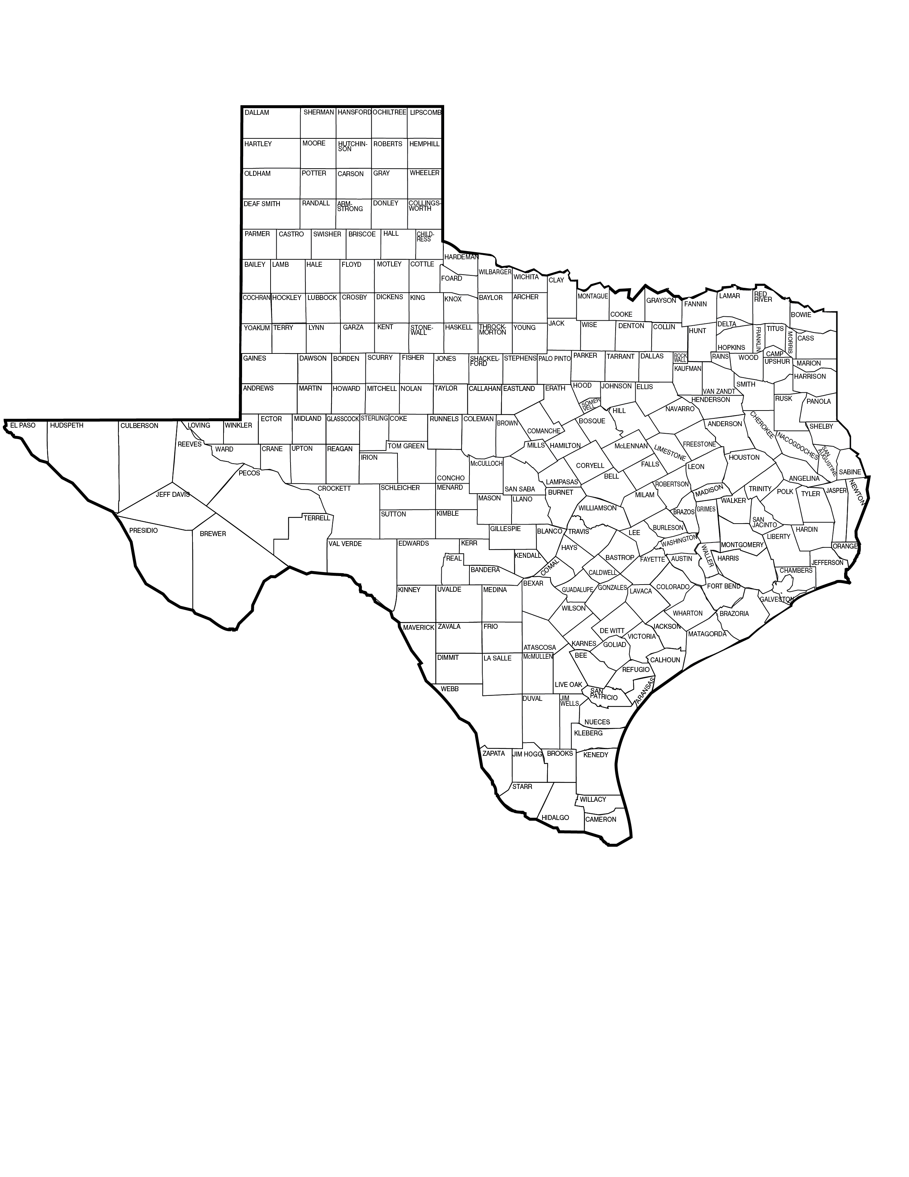
Cotton Planting
Cotton is a drought resistant crop
So, where is it grown in Texas?

Slide 4
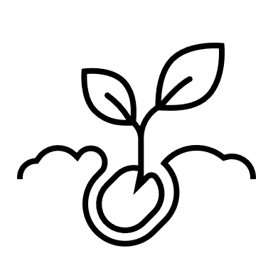
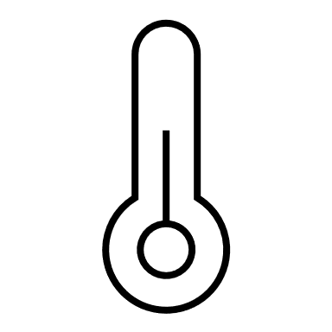
Cotton Planting
When is cotton planted in Texas?
Planting time varies depending on the location.
Overview of the Cotton Producing Regions of Texas
Take time to read and analyze this document
Planting requires a good awareness of the environmental conditions:
Temperature
Freezing conditions
Soil temperature
Moisture/Precipitation
Soil viability
Length of growing season

Slide 5
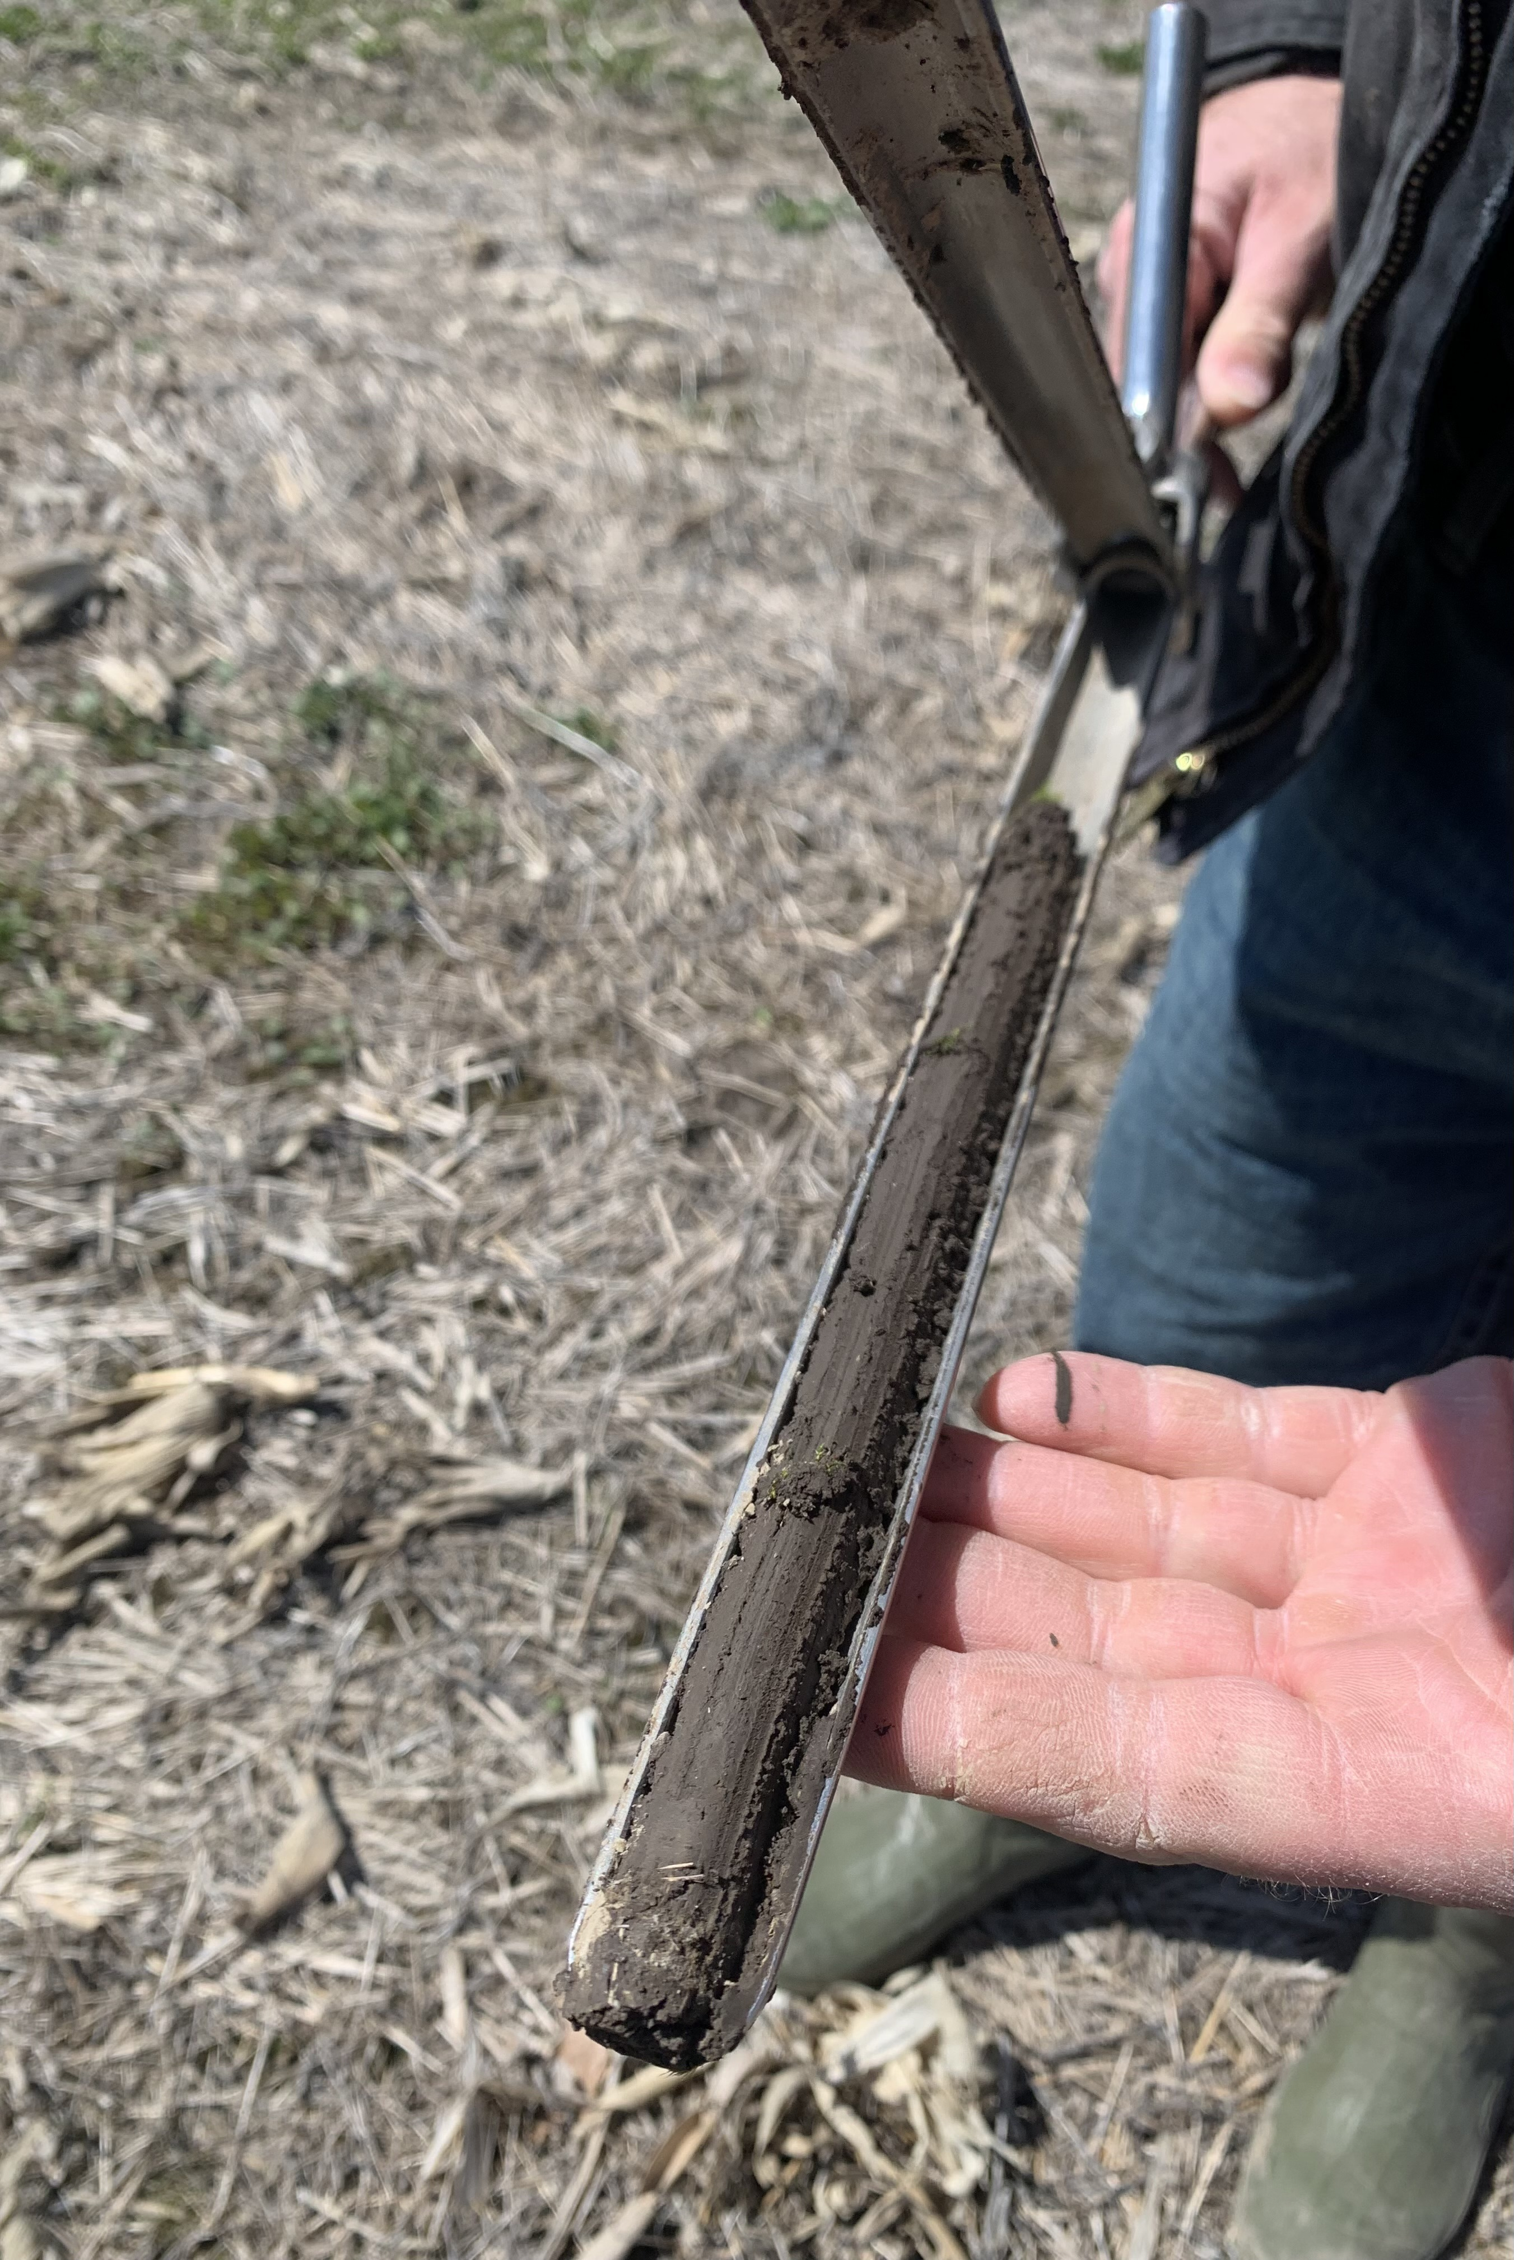
Cotton Planting
Soil Testing
Farmers test the soil before planting to determine soil viability and nutrient needs

Slide 6
Cotton Planting
Activity 1: What does the soil tell us?
Divide students into groups
Students will research how/where to send soil for testing
Students should consider contacting the local Texas A&M Extension office to learn about the process
Students will speak with a cotton farmer to learn more about why soil testing is important from his/her perspective
Conduct soil testing around the school (or school garden) OR coordinate with a local farmer to test his or her soil
The soil sample or samples should be submitted for testing and analyzed when results are received
Make conclusions and record a summary of conclusions on the “Soil Testing Conclusions and Summary” document
Research Should Answer:
What does soil testing reveal about the soil?
What components are ideal for the soil to include when growing cotton?

Slide 7
Cotton Growing Cycle

Slide 8
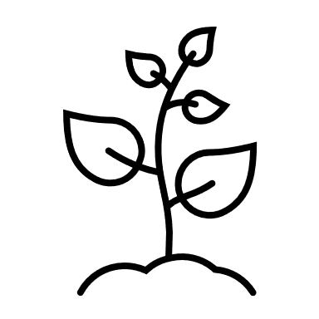
Cotton Growing Cycle
Stages of Growth
1. Germination and Emergence
2. Seedling Establishment
3. Leaf Area and Canopy Development
4. Flowering and Boll Development
5. Maturation (Open Boll)

Slide 9
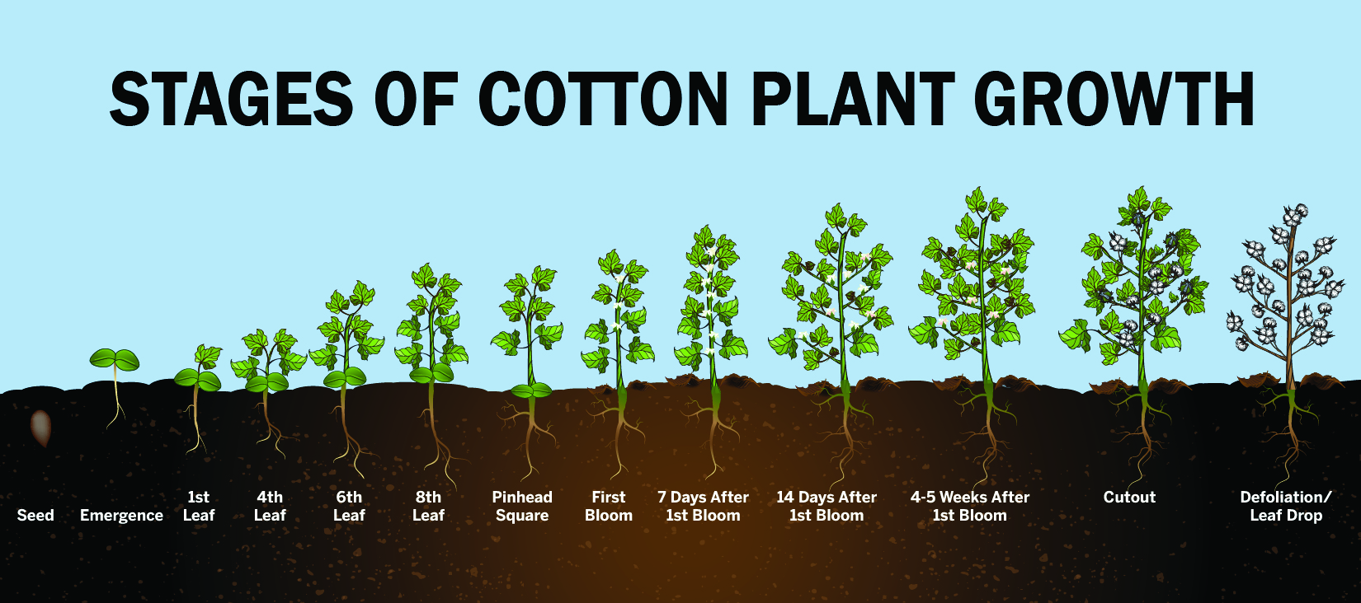
Cotton Growing Cycle

Slide 10
Cotton Growing Cycle
Weed Growth & Management
Weeds are the most common issue present throughout the growing cycle; however, pests can also be present at different growing stages
Weeds compete for the nutrients in the soil that the cotton plants need
Weed Management Techniques
Preventative
Cultural (I.e. prescribed fire)
Mechanical (I.e. mowing or shredding)
Biological (I.e. grazing livestock)
Chemical (I.e. Herbicide)

Slide 11
Cotton Growing Cycle
Weed Identification
Utilizing the Weed Management in Texas Cotton document, study the most common weeds found in Texas cotton fields
Dichotomous Key Identification
Practice using a dichotomous key to determine weed identity
https://prezi.com/ha-sf9j0ehkn/classified-crop-case-files/
Analyze weed samples using digital microscopes (if available)

Slide 12
Cotton Growing Cycle
Weed Control
Activity 2: Sample Chemical Program
Divide students into groups
Speak to two farmers about their responsible chemical program and how technology such as drones and other imaging identify issues in their fields
Determine: How does technology help and what limitations does such technology have?
Create a sample chemical program based on the following information. You should display your sample program in a PowerPoint or other creative outlet.
Consider:
Based on your conversations and knowledge gained from other research, what should your first step be when developing a chemical program to control weeds?

Slide 13
Cotton Growing Cycle
Weed Control
Activity 2: Sample Chemical Program
Program Parameters:
Mr. Smith farms cotton in Central Texas. After checking his fields, Mr. Smith noticed a weed issue in one of his fields. The issue is not present throughout the entire field; rather, the issue only seems to be present in three locations around the perimeter. To date, Mr. Smith has not utilized a consistent chemical program. It is June. What might the problematic weed be? Based on this information and what you learned through research, develop a plan to help Mr. Smith combat the weed problem from now until harvest. Your plan should also include a chemical program that Mr. Smith could follow during the next growing season (start to finish).

Slide 14
Cotton Harvesting

Slide 15
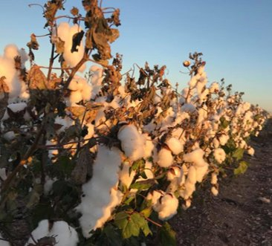
Cotton Harvesting
A cotton field is harvest ready when the leaves have been defoliated
How does defoliation occur?
Naturally (a freeze)
Chemical harvest aid
Harvest aid is sprayed on the plant to help it defoliate at a more rapid pace
The use of chemical harvest aid is region specific

Slide 16
Cotton Harvesting
Cotton Stalk Destruction
Cotton stalk destruction is necessary in some regions due to the boll weevil
The boll weevil is a major pest that feeds on the flowers and cotton buds
Cotton Stalk Destruction occurs:
1. Naturally (freeze)
2. Mechanically (plowing/tilling)
3. Chemically (herbicide)
Read more about cotton stalk destruction: Cotton Stalk Destruction with Herbicides

Slide 17
Cotton Harvesting
Cotton Stalk Destruction Zones
The government regulates cotton stalk destruction and specifies that by which stalks must be destructed
Texas Department of Agriculture Cotton Stalk Destruction Zones
Some counties are not in a zone due to the colder climate where it freezes; therefore, stalk destruction isn’t required because the freeze prevents regrowth

Slide 18
Cotton Harvesting
There are two different cotton harvesters used to harvest cotton out of the field
See page four of the Crop Profile for Cotton in Texas Document for details about the specifics of each technique.
The most significant difference between the two machines is the header on each. Look closely at the next two photos.
Cotton Harvest Techniques:
1. Cotton Stripper
2. Cotton Picker

Slide 19
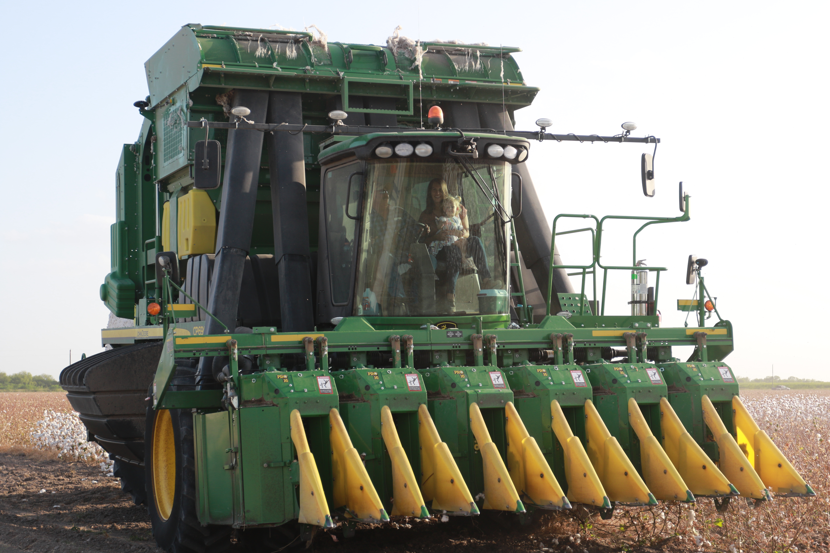
Cotton Harvesting
Cotton Picker

Slide 20
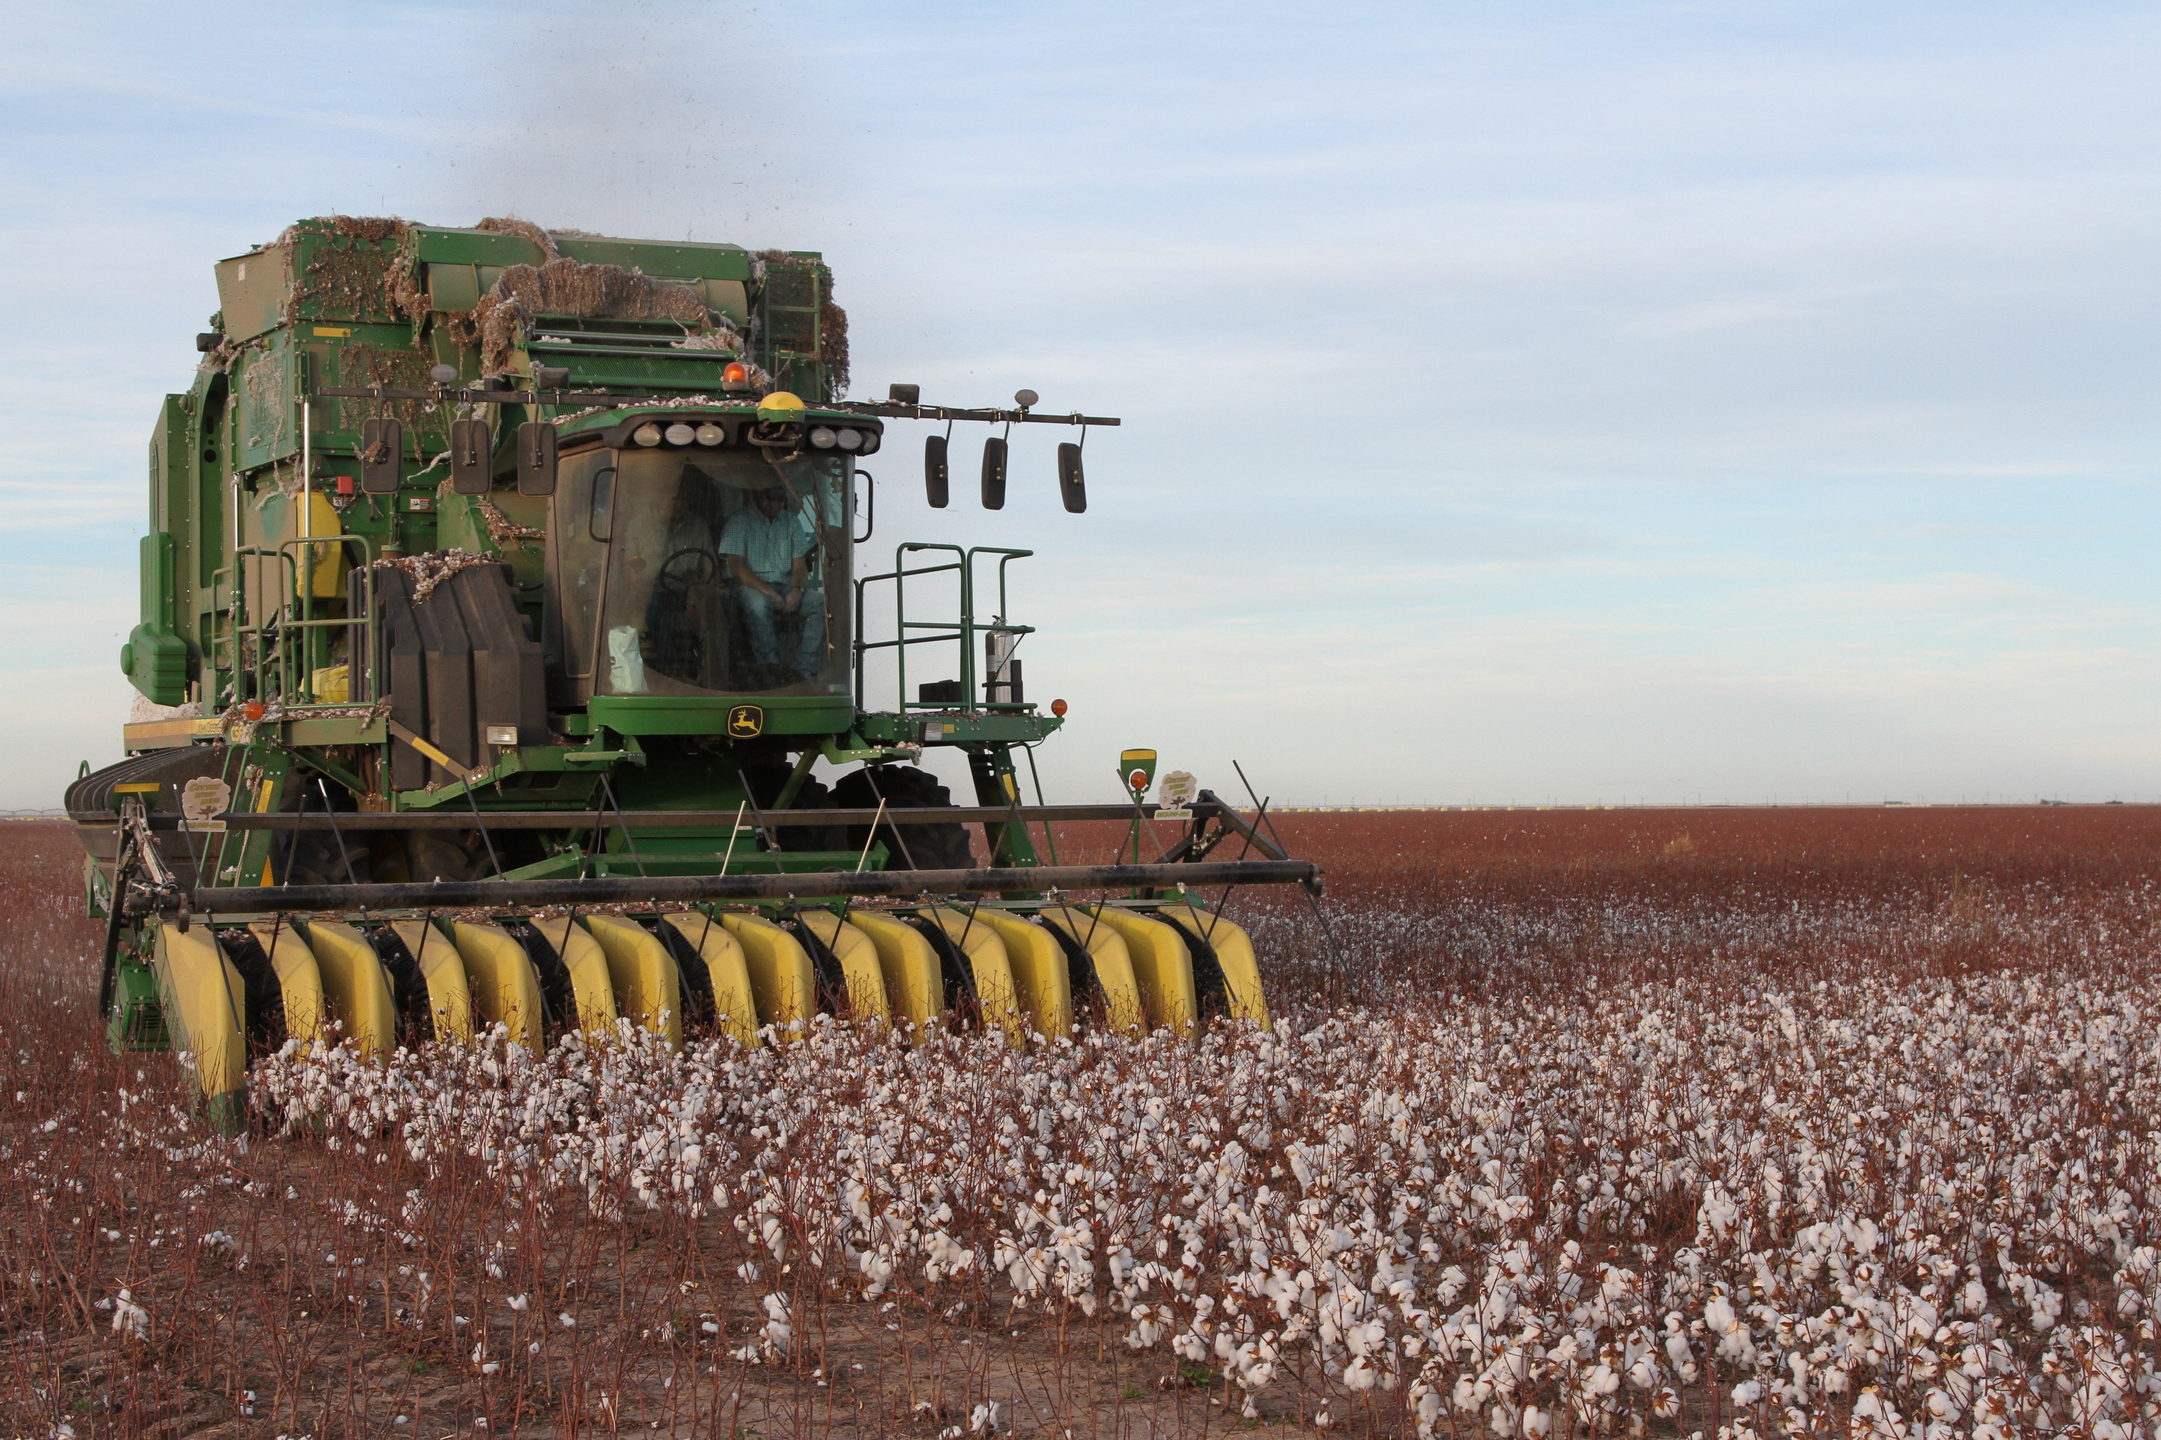
Cotton Harvesting
Cotton Stripper

Slide 21
Cotton Harvesting
Activity 3: Cotton Harvest
Divide students into groups
Assign each group a Texas county
Each group should identify the cotton stalk destruction zone that the county is in (if the county is in a zone)
If the county is not in a zone, why not?
Create a creative 3-minute educational video that could be used in a public setting to teach about cotton production in the area that they research
Research the harvest details for that county:
1. Harvest date
2. Use of a harvest aid or no harvest aid
3. Harvest technique
4. Average yield for that area *What factors contribute to yield?
5. Other details interesting and pertinent to growing cotton in that area

Slide 22
Cotton Ginning

Slide 23
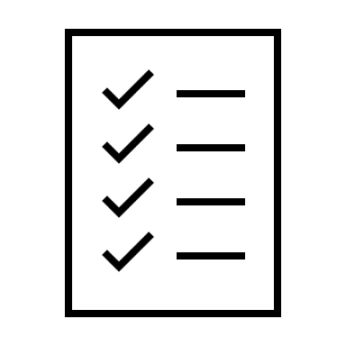
Cotton Ginning
Test Your Knowledge
Join the Nearpod Quiz
Utilize the access code from your teacher

Slide 24
Cotton Ginning
Test Your Knowledge
Quiz Yourself!
1. Who invented the cotton gin?
2. What year was the cotton gin invented?
3. Where (city and state) is the largest cotton gin in the United States located?
4. What is the fiber called that is left on the seed once the majority of lint is removed during the ginning process?
5. True or False: The cotton gin cleans the cotton AND separates the link from the seed.
6. True or False: Cotton seed is used to feed cattle.
7. Which of the following foods contains cotton seed oil? Peanut Butter Milano Cookies Cream of Mushroom Soup All of the Above

Slide 25
Cotton Ginning
Adobe Walls Gin

Slide 26
Cotton Ginning
The Ginning Process
Read to learn more about the ginning process
Watch the following “Cotton Ginning Process” video

Slide 27
Cotton Ginning
The Ginning Process
Think Critically!
What careers do you see, not see (i.e., those who might work behind the scenes or not directly in the gin), and think of when you watched the video that play a role in getting cotton from the field to the store?

Slide 28
Cotton Ginning
Activity 4: Careers
Divide students into groups
Each group should pick a different career from the “Career Cluster” handout and research it
After researching each group should give a presentation to the class as if they work for the human resource department of a company hiring for this position
Students should role play and present why this job is one someone should consider
*The following information must be provided, but students are encouraged to be creative and provide all the information about the role and the company that might be of interest to a qualified candidate.
1. Career
2. Education Requirements
3. Salary/Pay
4. Location
5. What is an employer looking for (i.e., expectations) in a person who fulfills this role?

Slide 29
Cotton Ginning
How does the farmer get paid?
Overview
Farmers must wait on the cotton to be ginned and graded before being paid
The farmer’s pay is dependent on the grade of the cotton – each bale of cotton is graded in a USDA laboratory. The better the cotton grades, the more the farmer is paid

Slide 30
Dollar Breakdown

Slide 31
The Farmer’s Share
Where does the money go when we purchase food?
Misconception:
When food prices increase in the grocery store, the farmer gets paid more.
Truth:
Farmers do not necessarily get paid more when food prices increase in the grocery store For example, if fuels prices go up and cause an increase in food prices, farmers and ranchers do not benefit from the food price increase. How do you know about specific brands of food? The brands behind your favorite syrup, cereal, or ice cream use advertising to promote and garner interest from consumers, retailers, and purchasers in the restaurant industry

Slide 32
The Farmer’s Share
Test Your Knowledge
Join the Nearpod Quiz
the access code from your teacher

Slide 33
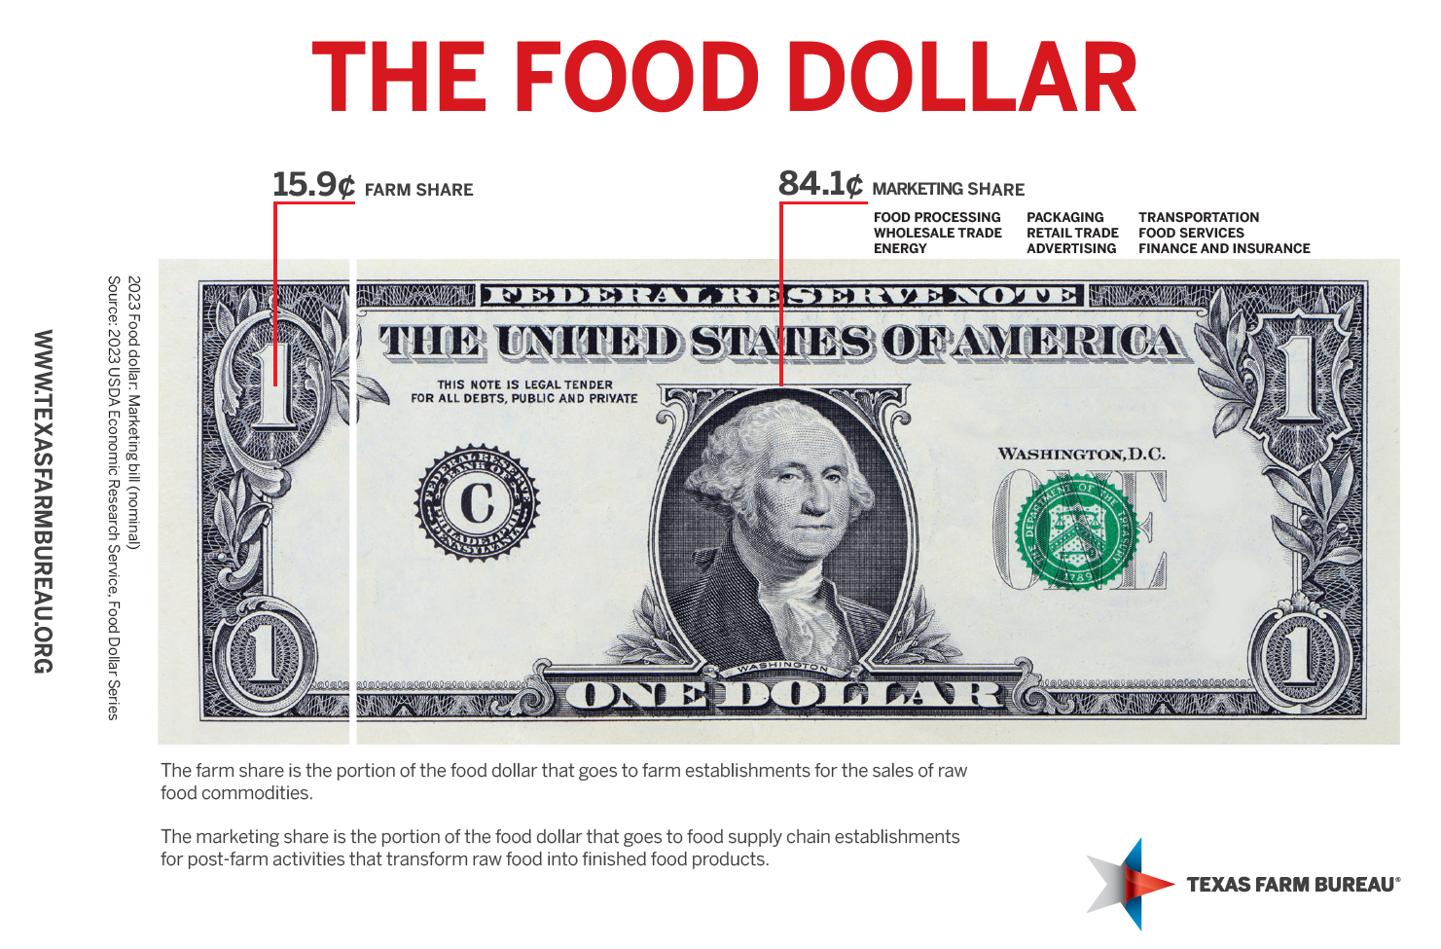
The Farmer’s Share
Where does the money go when we purchase food?

